Slide 1
Viral Push
Add Friend Reward Premium

Slide 2
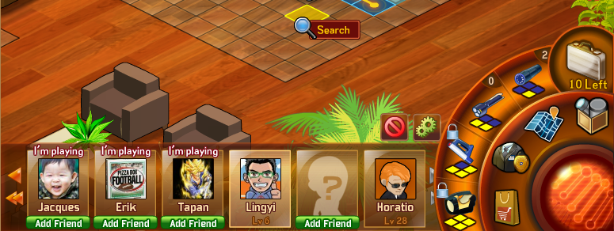
UI-1
Free Shields
Add Friend

Slide 3
UI-2
Add Friend to earn the reward
Free Shields
Add Friend

Slide 4
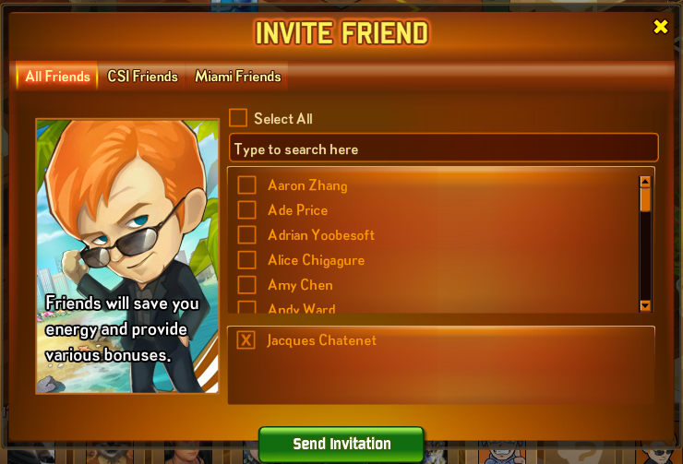

UI-3
You will be rewarded 2 shields for each new player joined the game!

